Slide 1
Help to Start Lab on flex

Slide 2
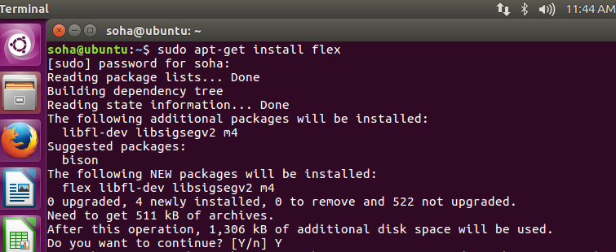
Install FLEX, preferably on Linux

Slide 3
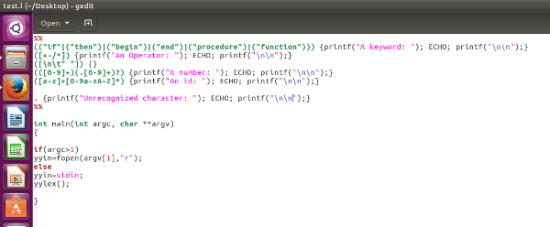
A working flex code for making improvements
Permission: Code can be copied from the comments for saving time.
Notes:
%%
(("if"|("then")|("begin")|("end")|("procedure")|("function"))) {printf("A keyword: "); ECHO; printf("\n");}
([+-/*]) {printf("An Operator: "); ECHO; printf("\n");}
([\n\t" "]) {}
(([0-9]+)(.[0-9]+)?) {printf("A number: "); ECHO; printf("\n");}
([a-z]+[0-9a-zA-Z]*) {printf("An id: "); ECHO; printf("\n");}
. {printf("Unrecognized character: "); ECHO; printf("\n");}
%%
int main(int argc, char **argv)
{
if(argc>1)
yyin=fopen(argv[1],"r");
else
yyin=stdin;
yylex();
}

Slide 4
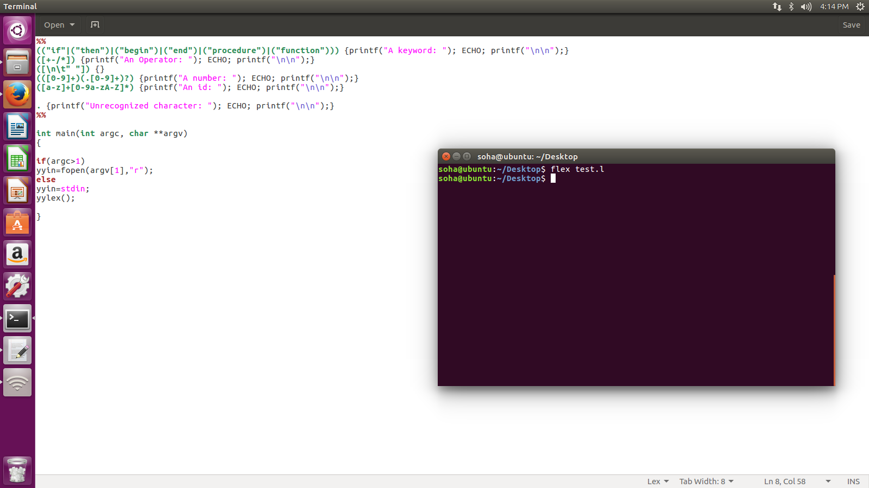
flex test.l

Slide 5
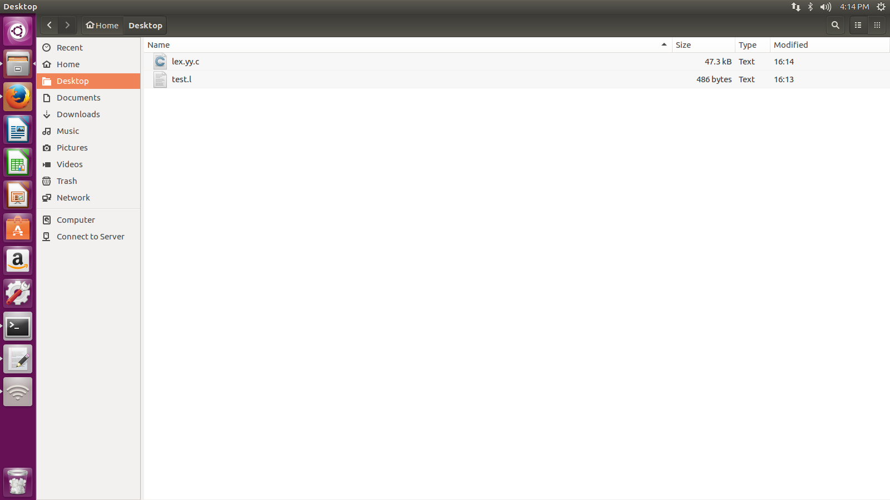
flex will produce C code in lex.yy.c

Slide 6
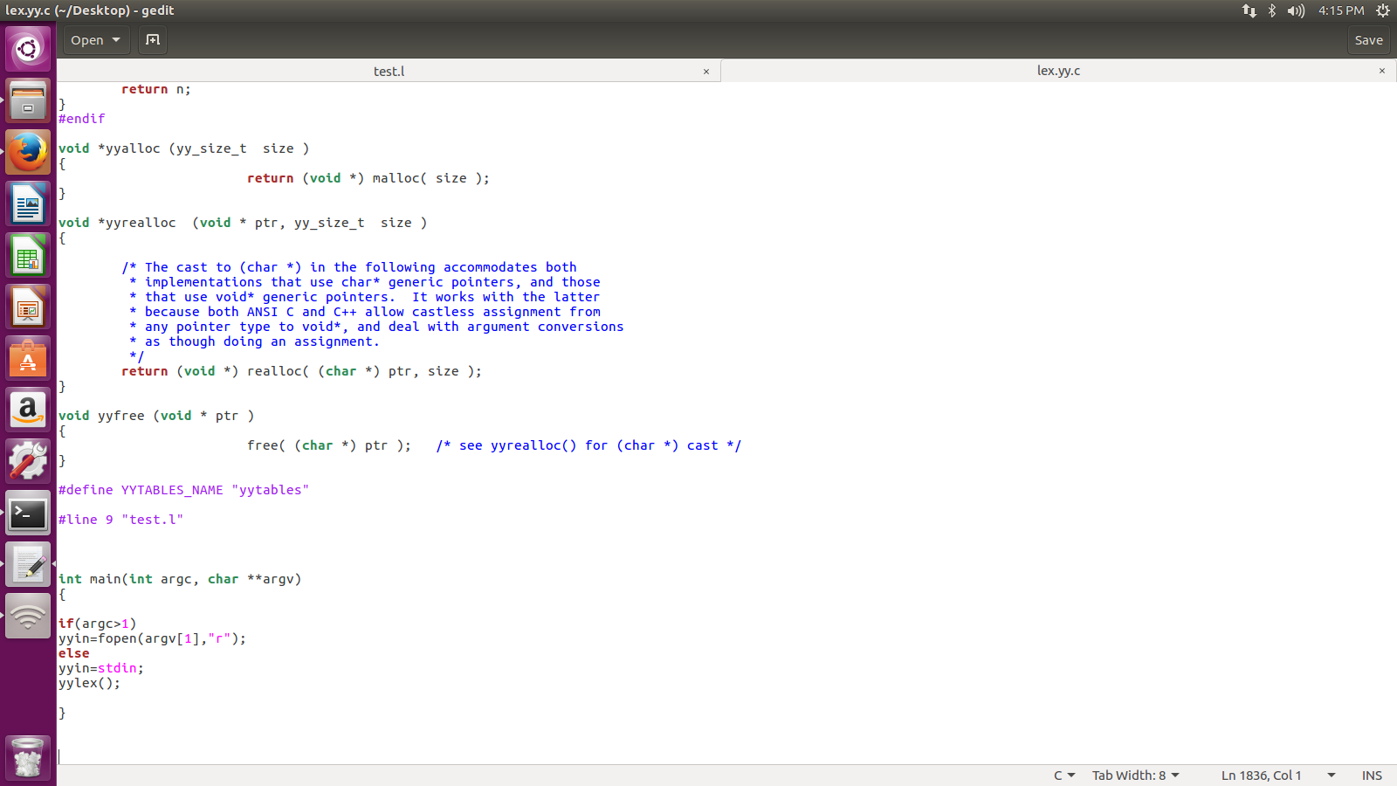
Output in C could be 100 times lengthier than the input

Slide 7
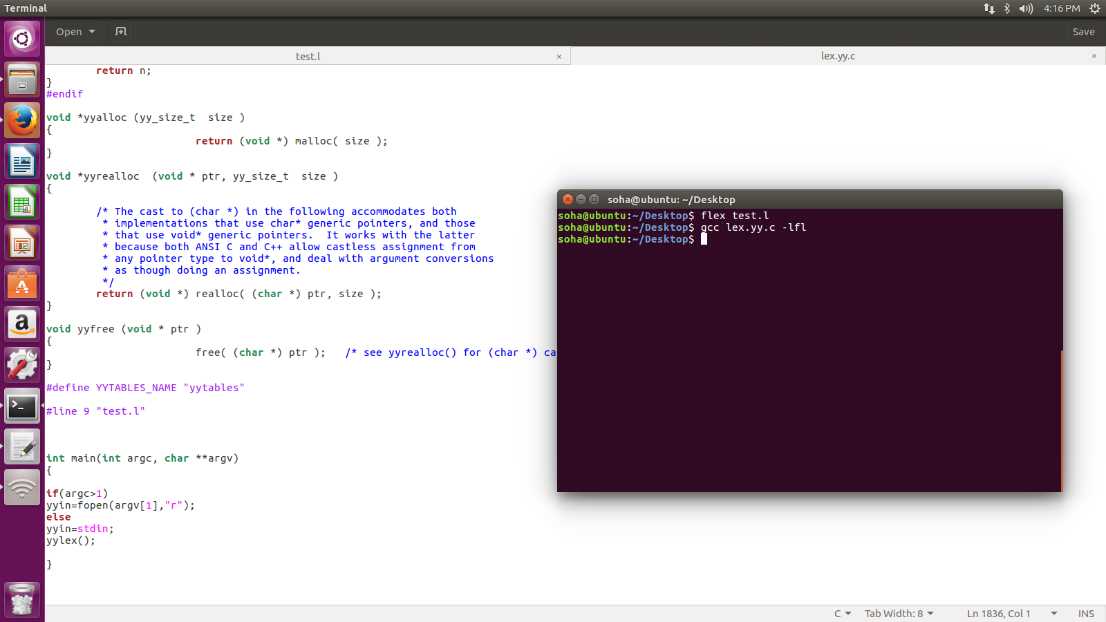
Compile generated lex.yy.c

Slide 8

Run a.out

Slide 9
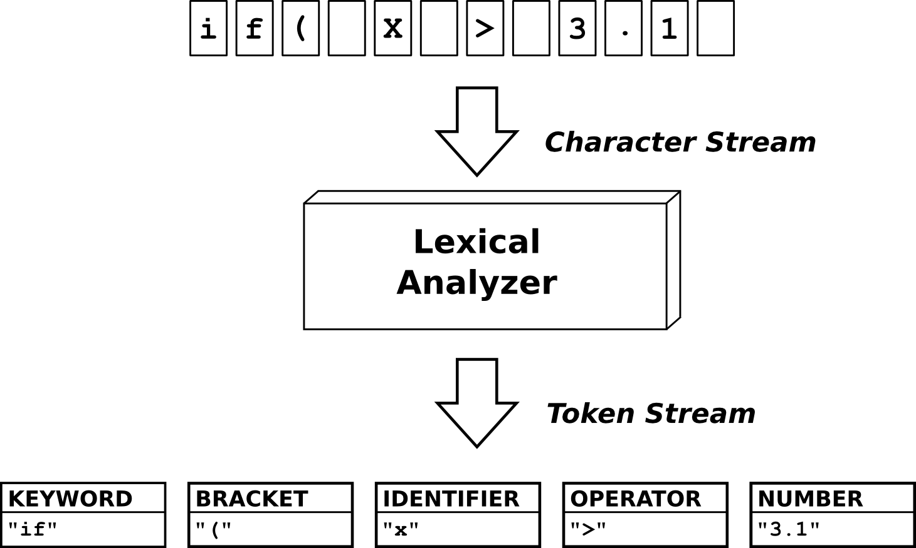
Our Lexical analyzer will generate tokens

Slide 10

if 5 > 92; Works nice, unable to produce token for ‘operator’

Slide 11
Lab 04 Task_1: Overcome this deficiency of not recognizing the operators Lab 04 Task_2: Propose any improvement of your own choice and demonstrate it in Word file

Slide 12
Thank You!

Slide 13
Recall:
A flex program to read a file of (positive) integers and compute the average:
%{
#include <stdio.h>
#include <stdlib.h>
%}
digit [0-9]
%%
{digit}+ return atoi(yytext);
%%
void main(){
int val, total = 0, n = 0;
while ( (val = yylex()) > 0 ) {
total += val;
n++;
}
if (n > 0) printf(“average = %d\n”, total/n);
}
Defining and using a name
definitions
char * yytext;
a buffer that holds the input characters that actually match the pattern
rules
Invoking the scanner: yylex()
Each time yylex() is called, the scanner continues processing the input from where it last left off.
Returns 0 on end-of-file.
user code
Notes:
Pattern to match C-style comments: /* … */
"/*"(.|\n)*"*/"

